Slide 1
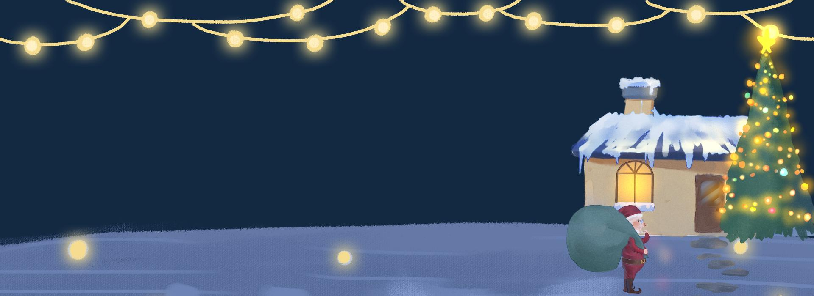


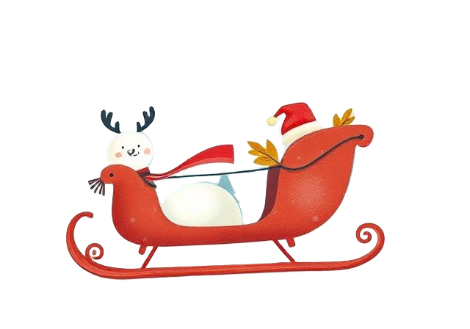
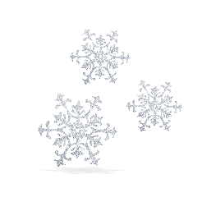

Ho
Ho
Merry
Ho!
Chrismas
NhanNgocThach – For Educational Use Only

Slide 2
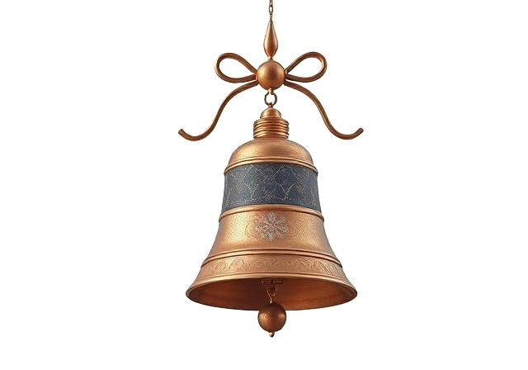

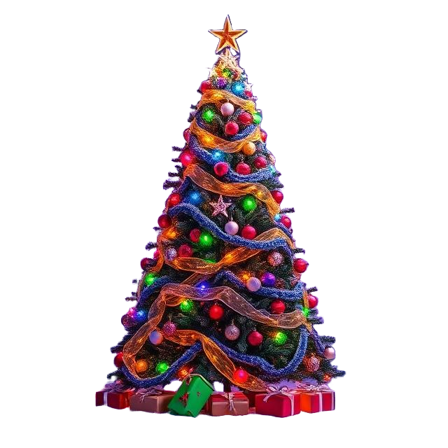
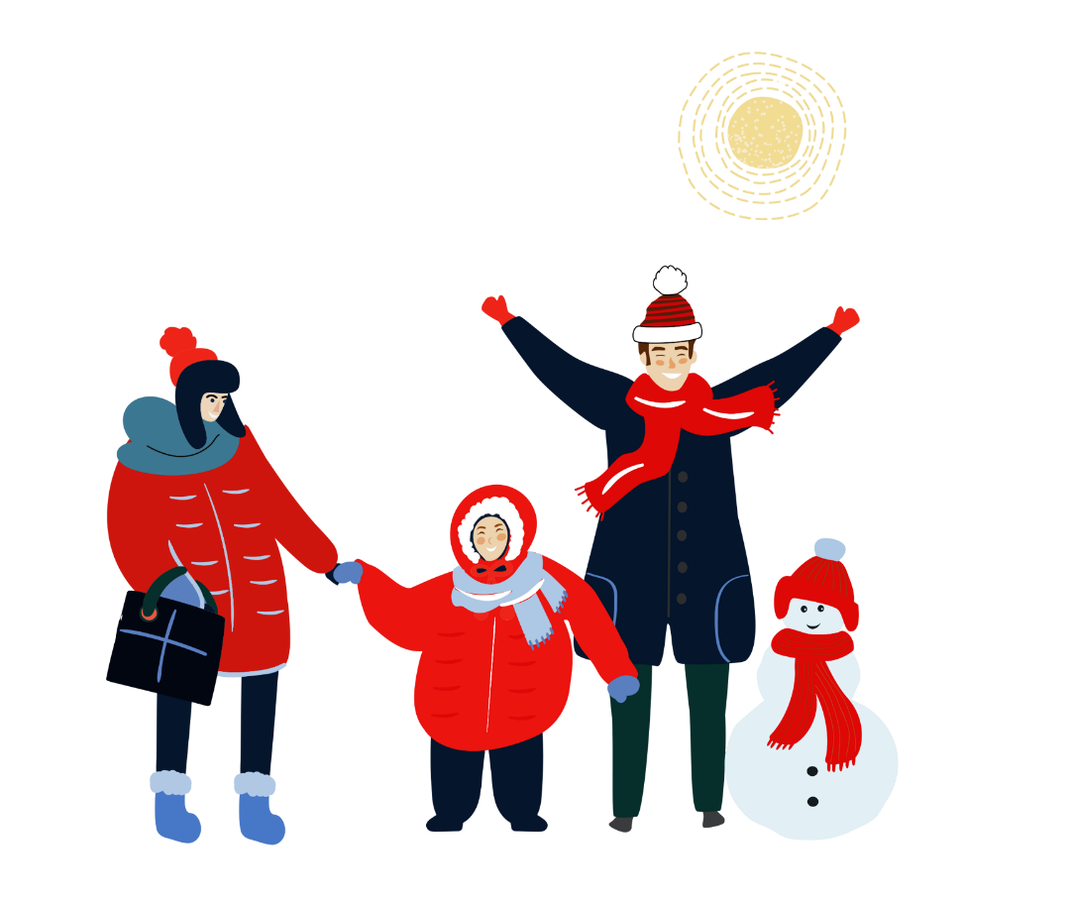
01
The history of Chrismas Day
02
Ceremonies & Activities
03
Special Foods
NhanNgocThach – For Educational Use Only
04
Chrismas Themes

Slide 3


The history of Chrismas Day
NhanNgocThach – For Educational Use Only

Slide 4
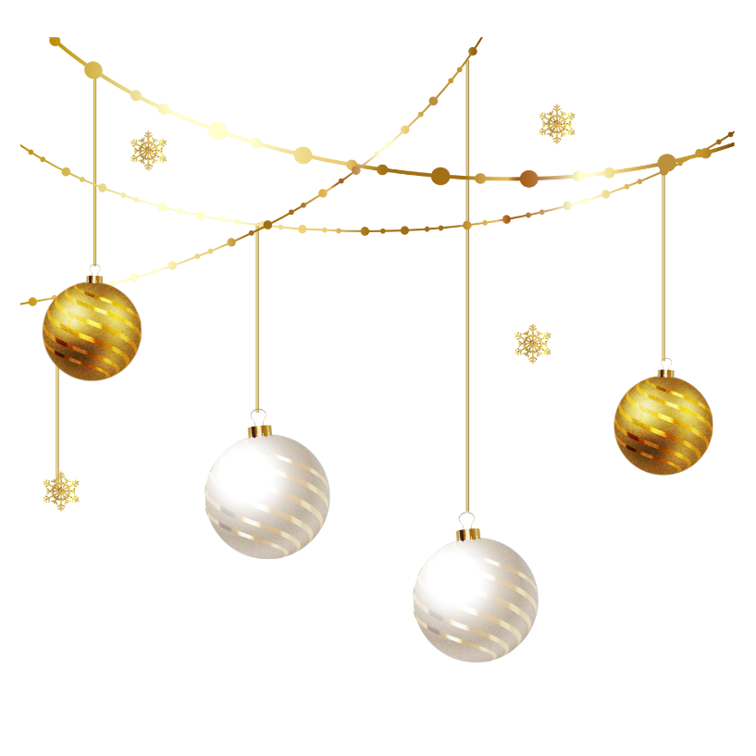


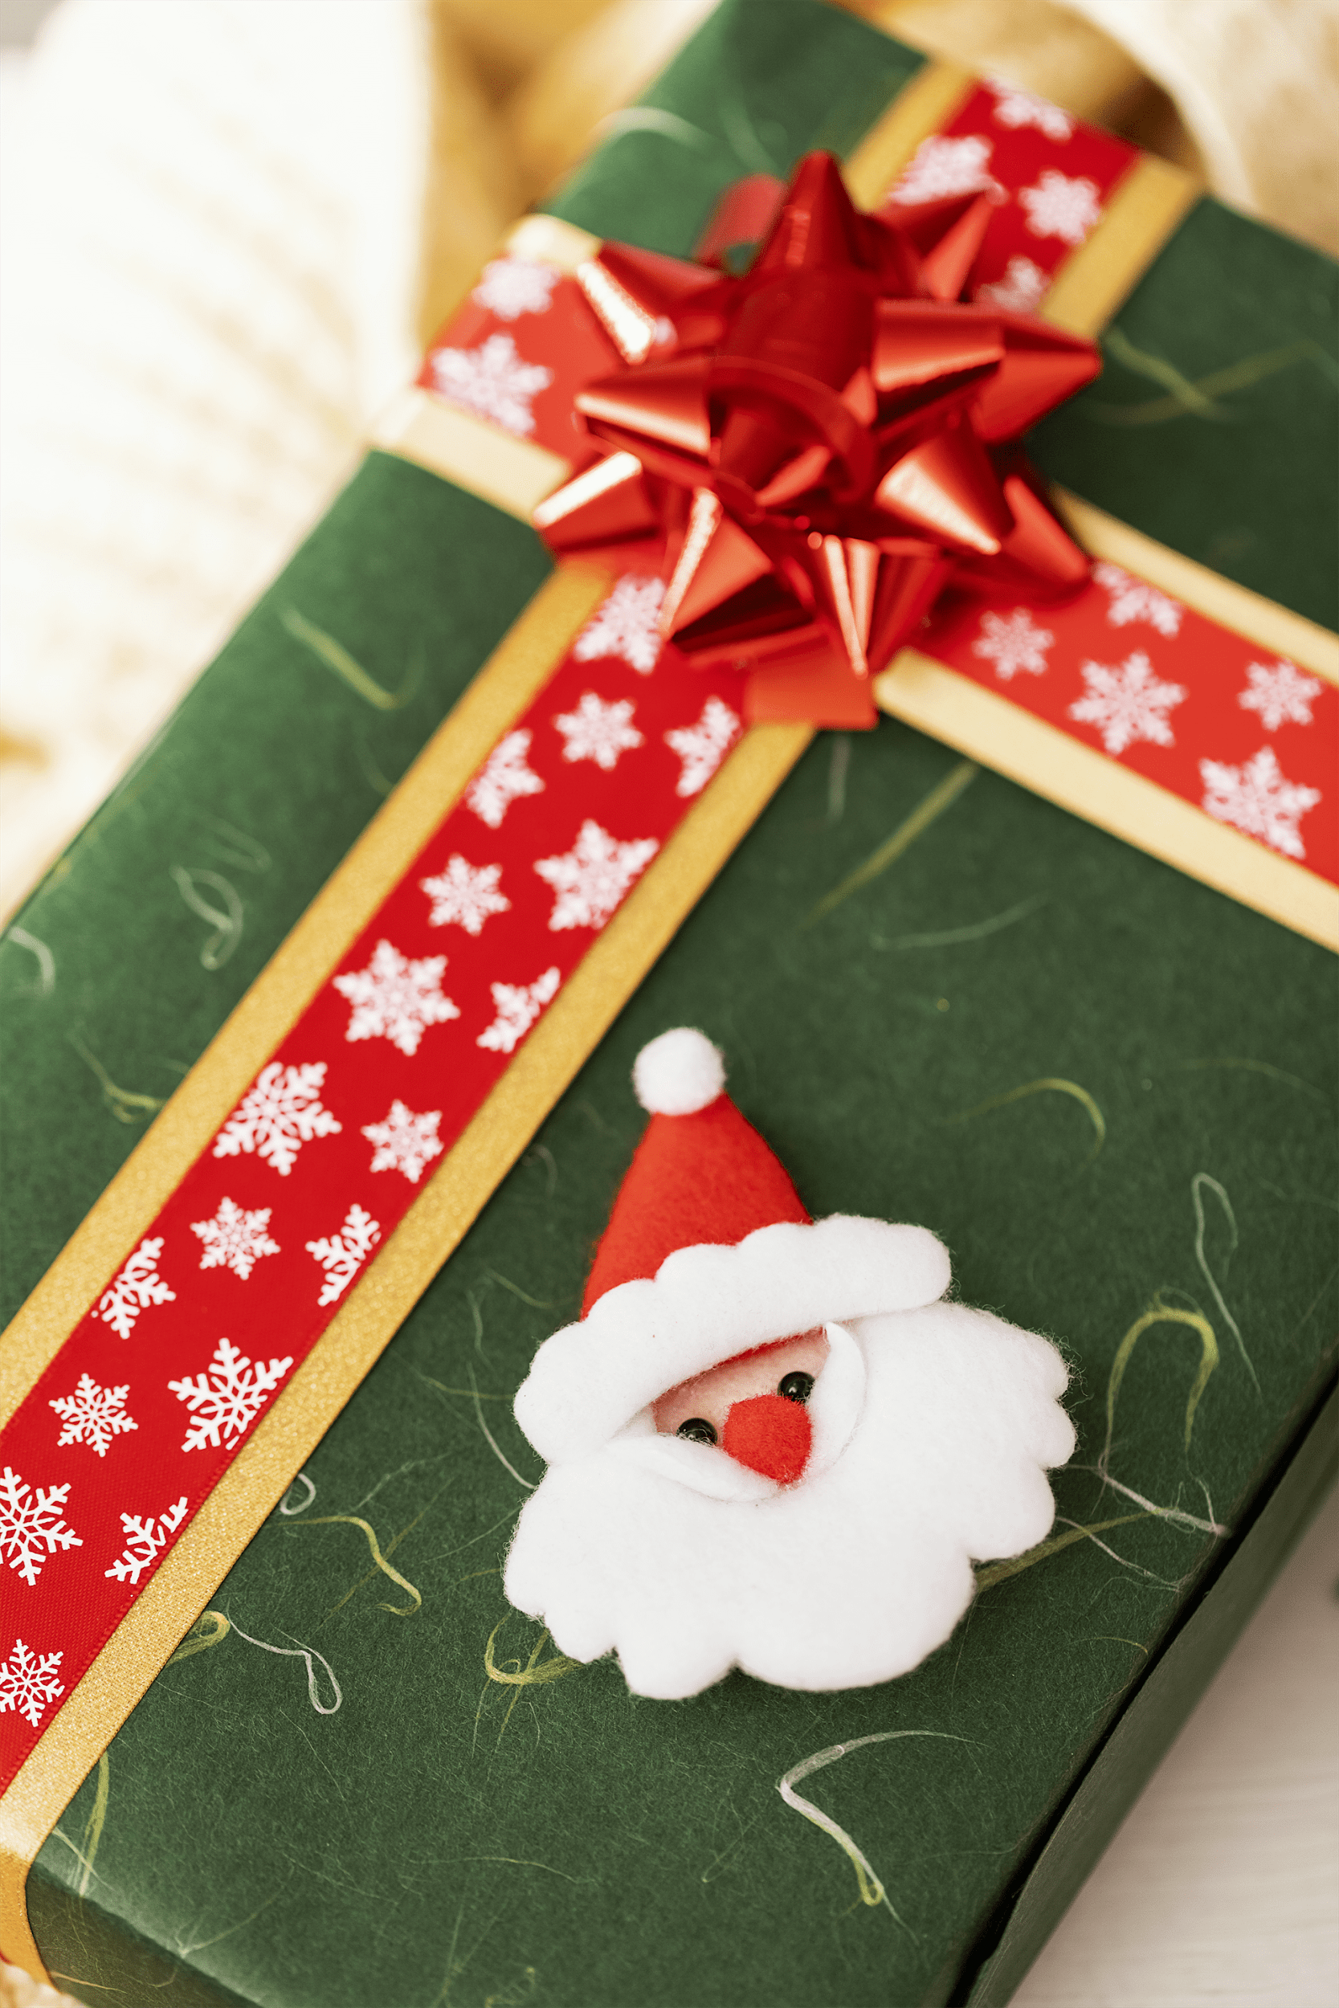
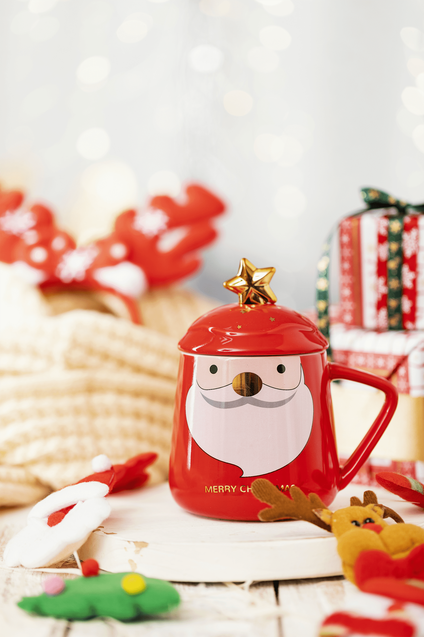
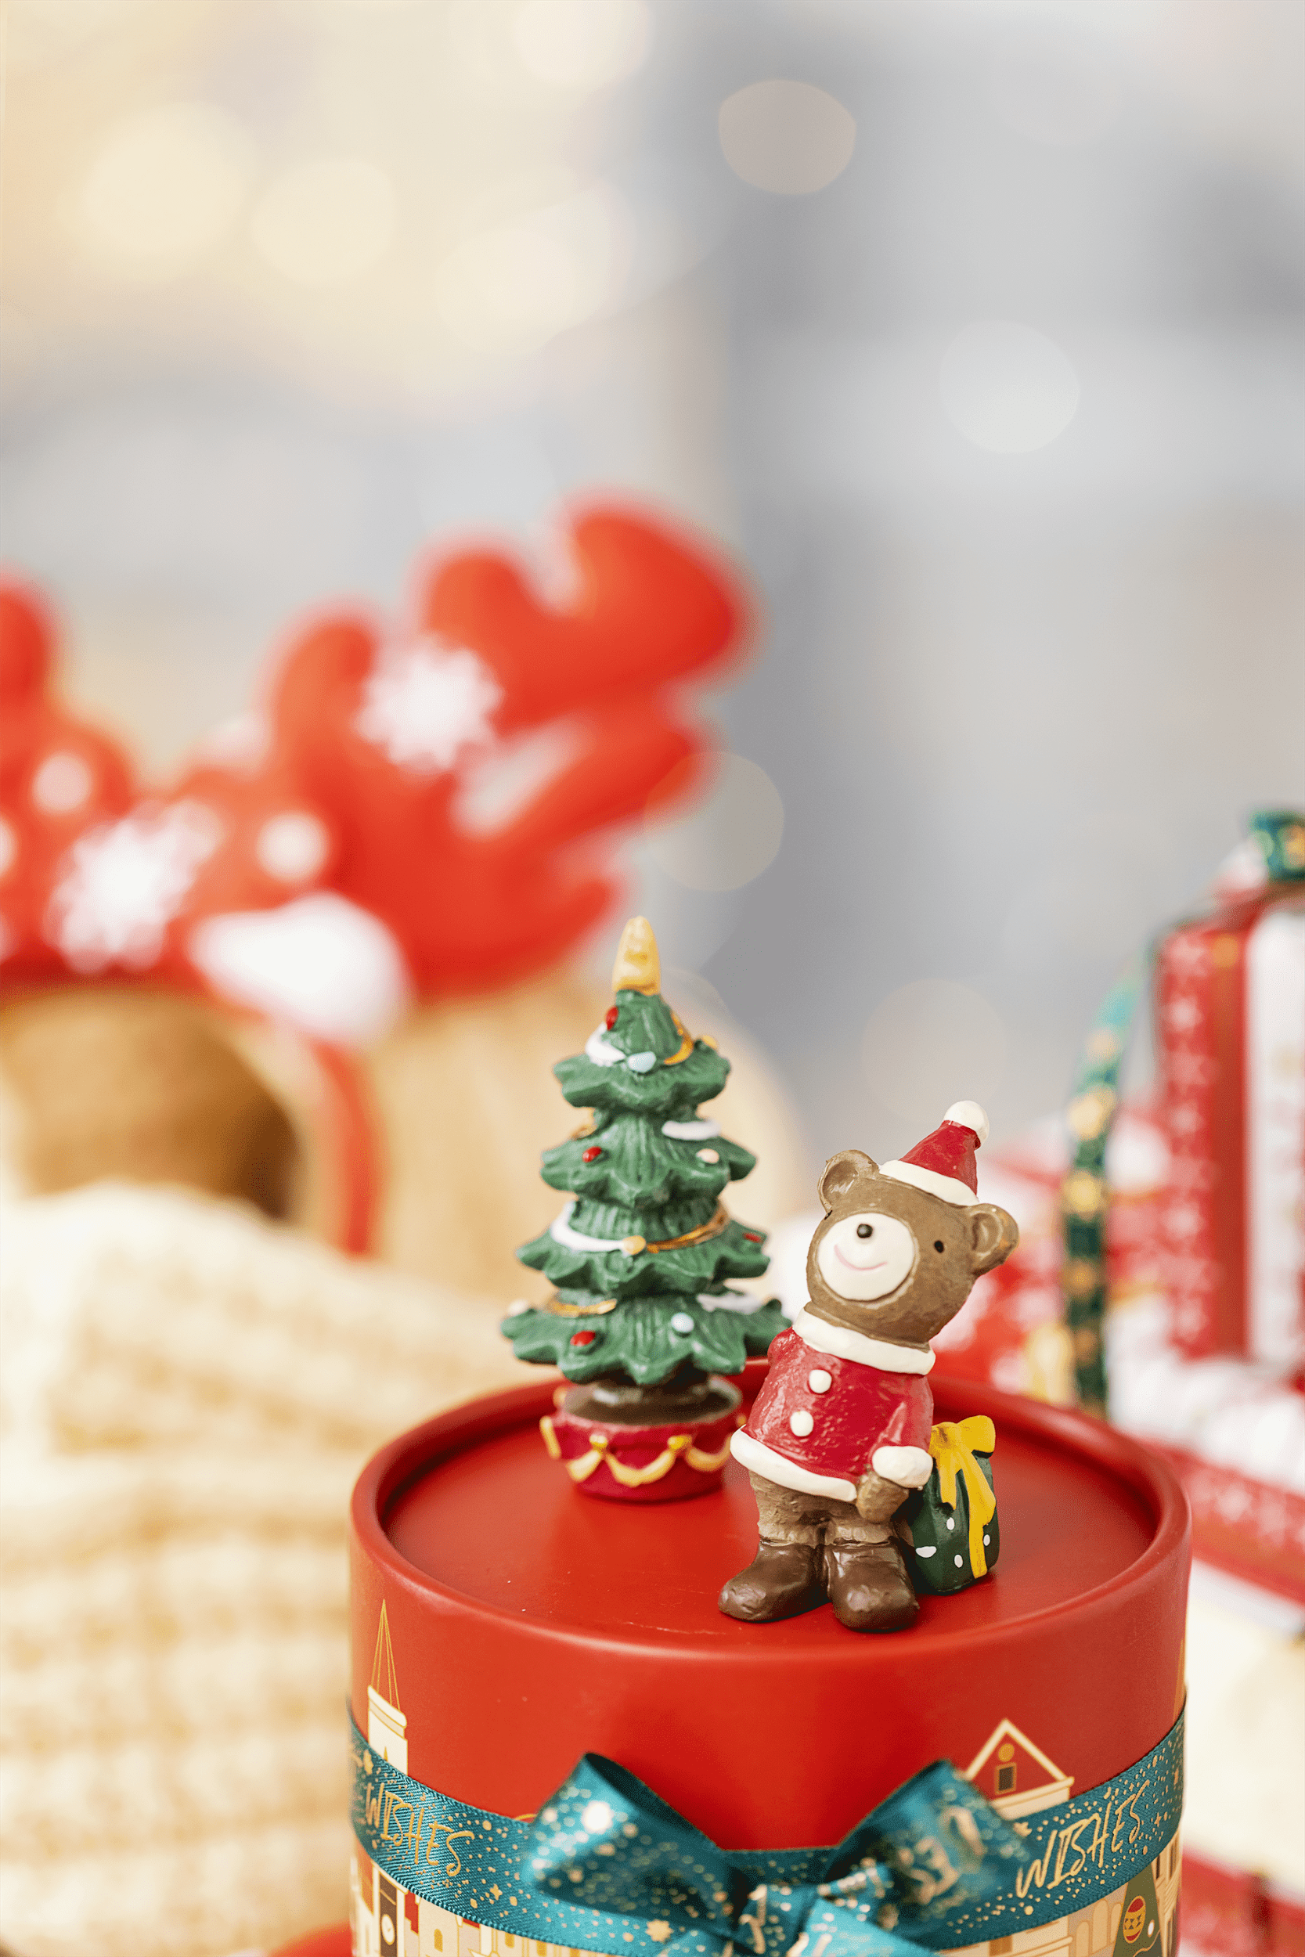
December 24 Christmas Eve: On this day, angels tell people the news that Jesus is about to be born, and now it has evolved to express blessings and love in the hearts of everyone
December 25 Christmas day: It is the Christian commemoration of the day when the Virgin Mary gave birth to Jesus
January 7 Christmas day: This is mainly the Christmas of Orthodox Christians, because they use the traditional Julian calendar, so the dates are not quite the same.
NhanNgocThach – For Educational Use Only

Slide 5
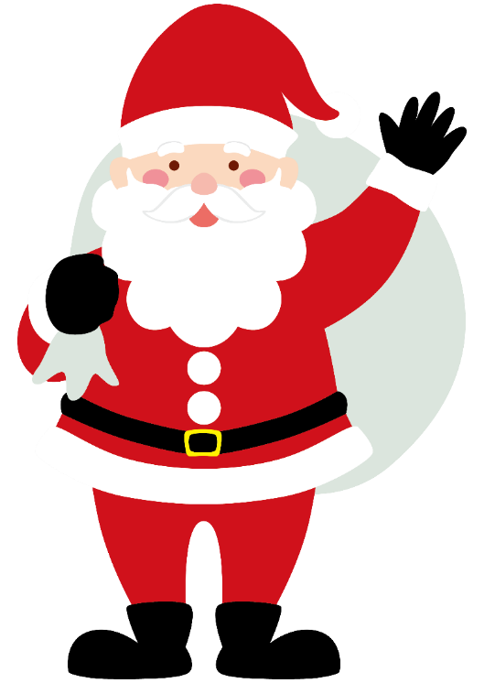

Christian tradition: December 25 is considered the birthday of Jesus Christ. This date was officially established in the 4th century AD to celebrate the birth of Jesus Christ.
Winter Solstice Festival: In many cultures, the winter solstice (usually on December 21 or 22) is a symbol of the return of light. Choosing a few days after the winter solstice to celebrate Christmas helps connect with the theme of light and hope.
NhanNgocThach – For Educational Use Only
Fusion Festival: In order to integrate pagans, early Christianity set Christmas on the same day as the Roman Sun God Festival, so as to better spread in the Roman Empire

Slide 6

Ceremonies
& Activities
NhanNgocThach – For Educational Use Only

Slide 7

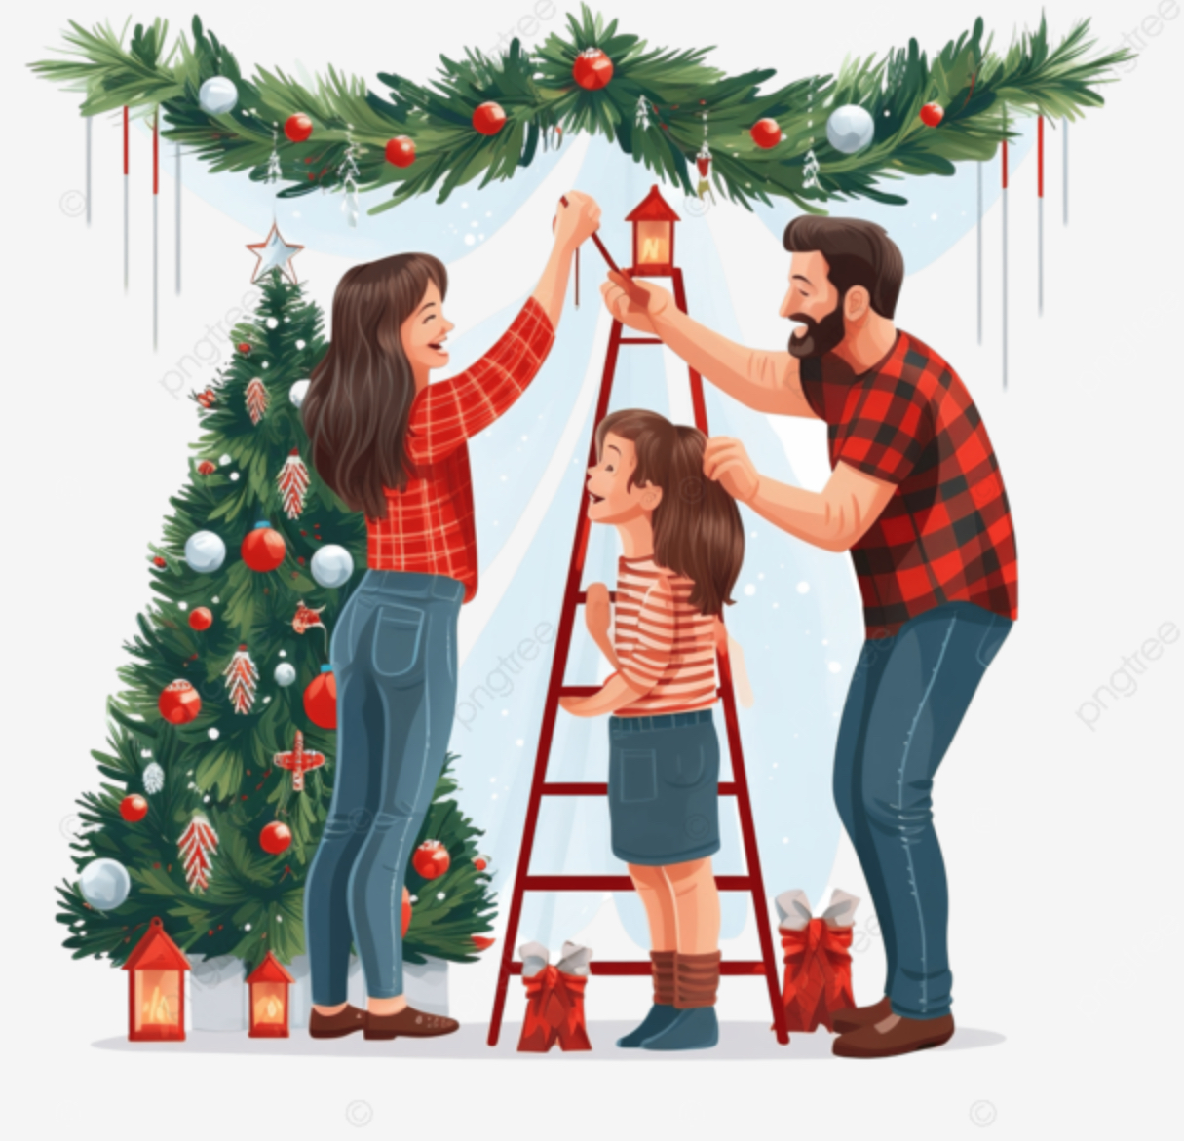

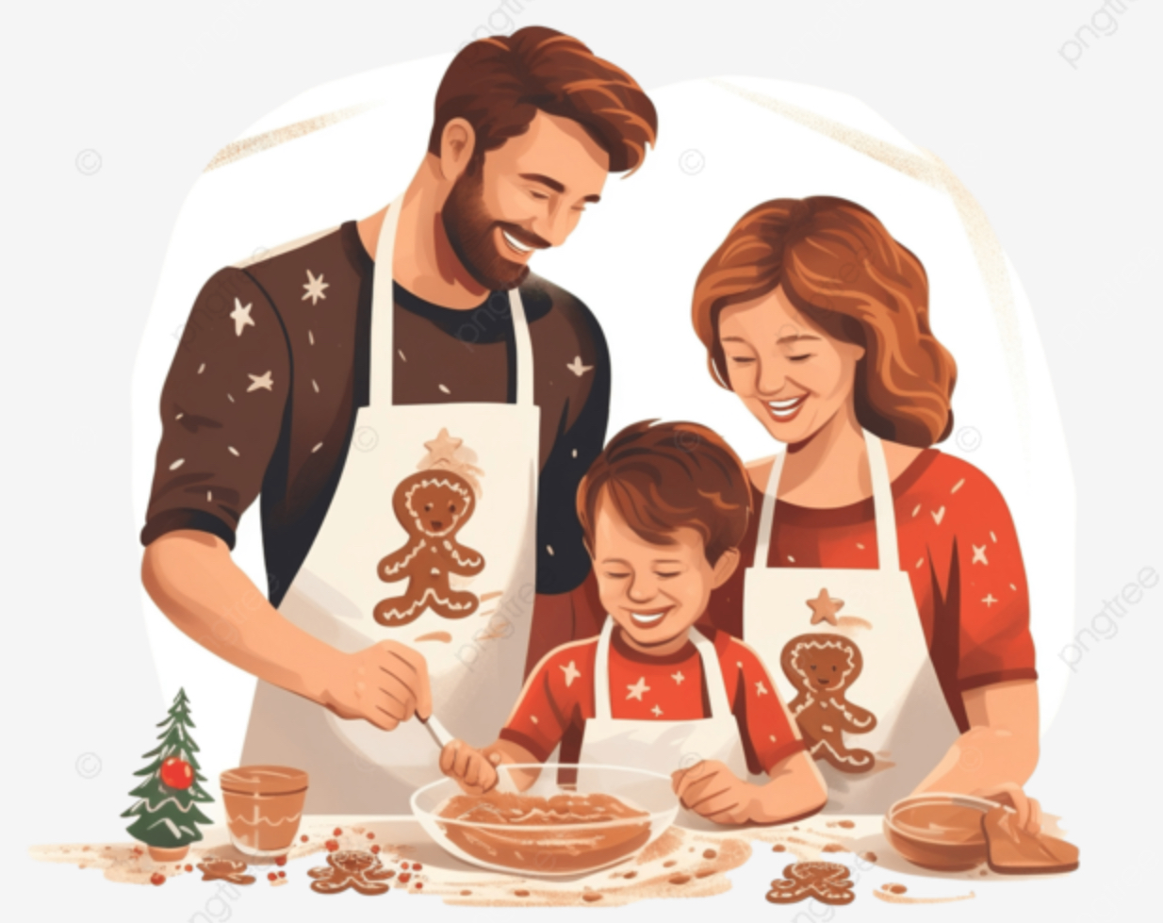
Decorating the house for Christmas
Make the Christmas tree with the family
NhanNgocThach – For Educational Use Only
Making cookies with Christmas-themed shapes

Slide 8

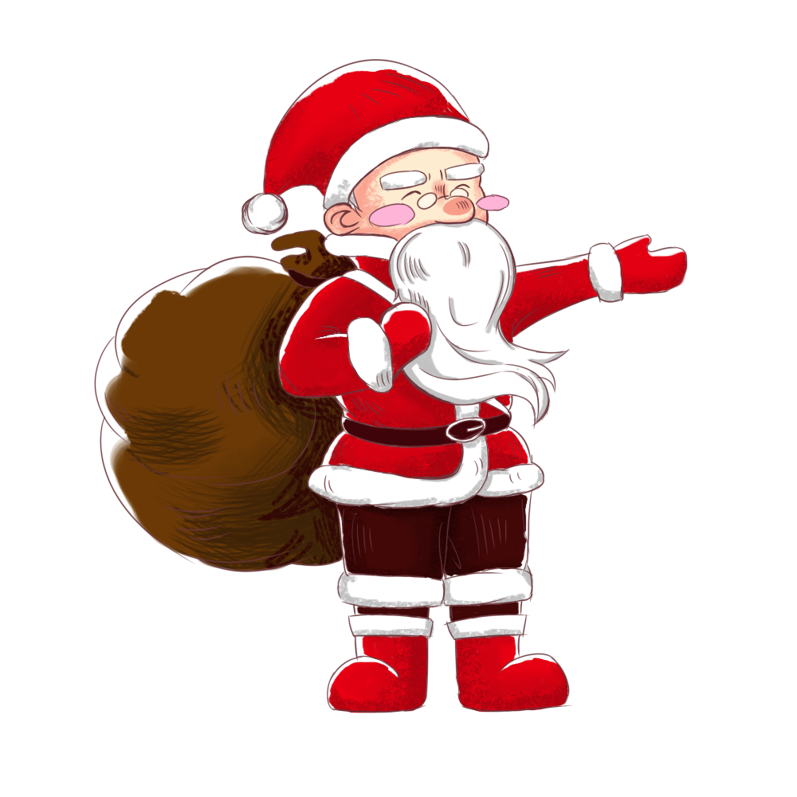
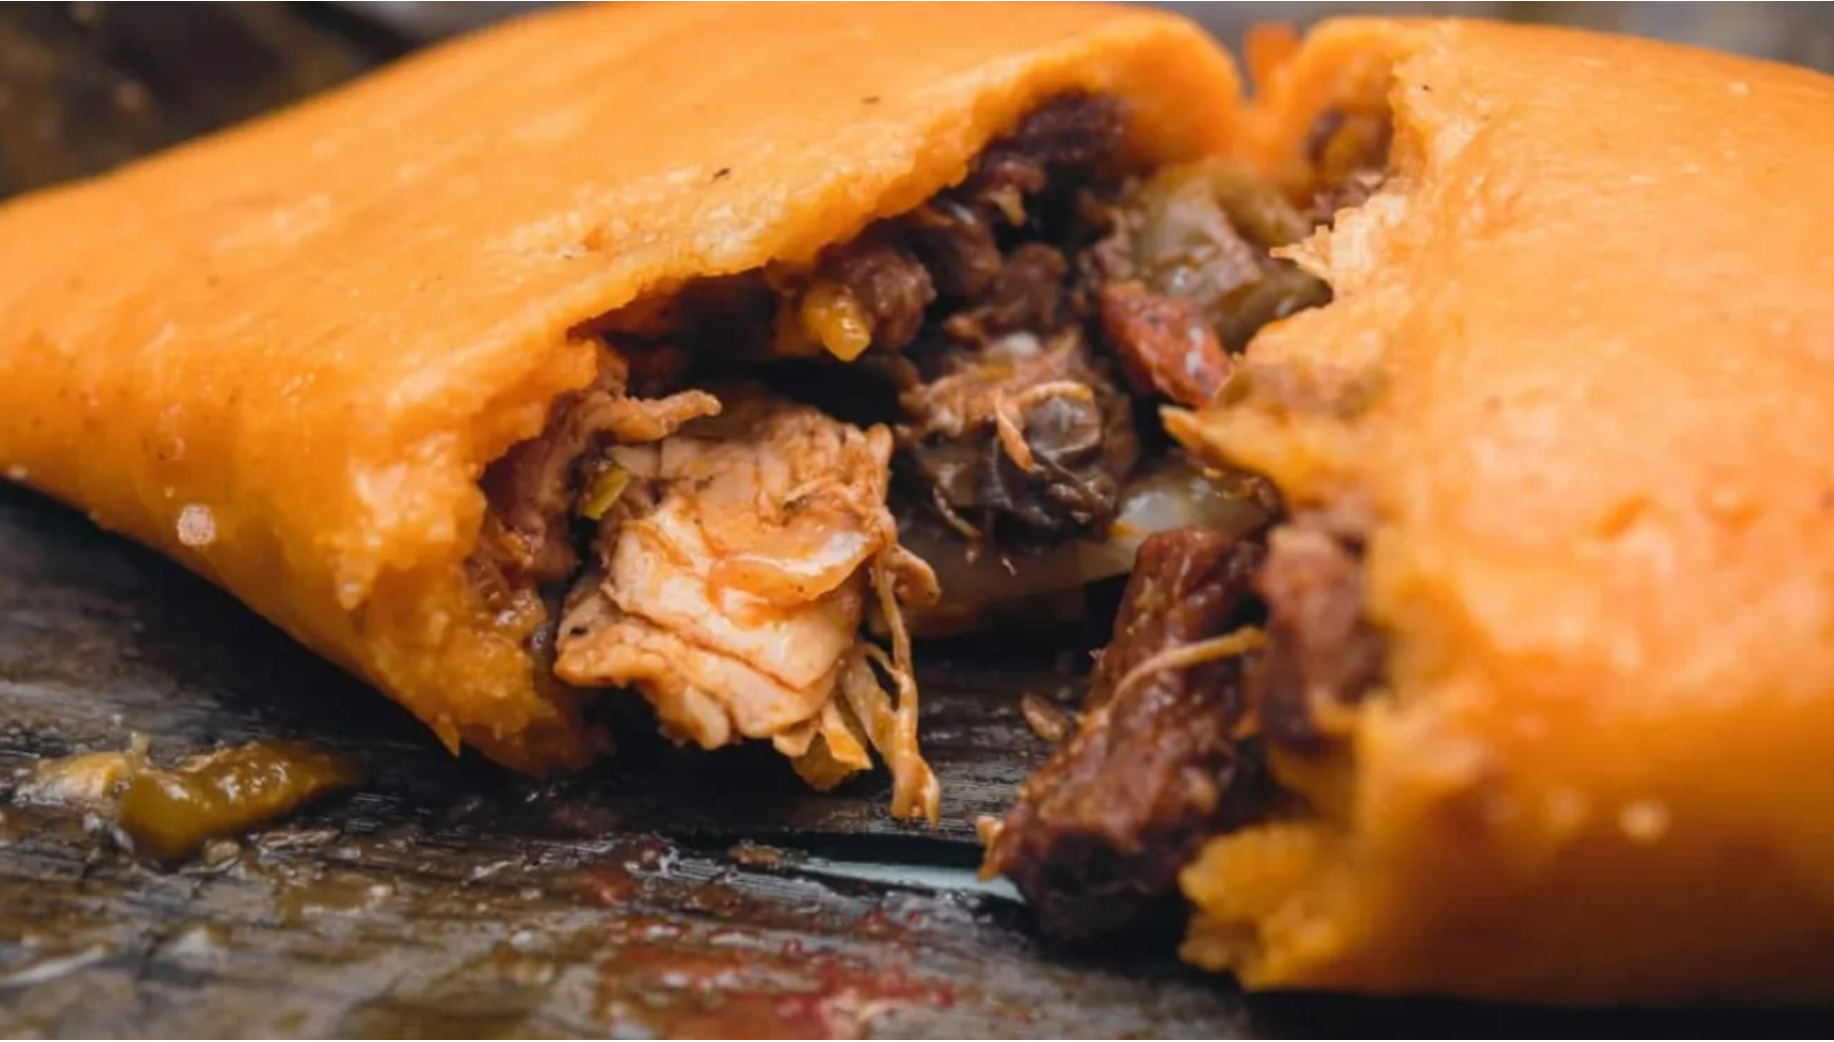
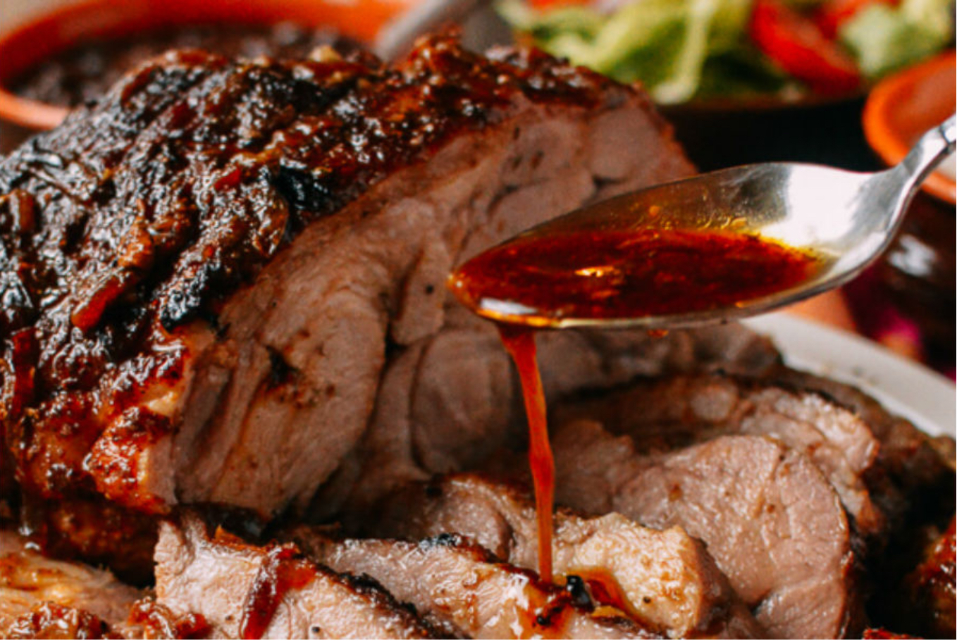
Days before christmas
Choose with the family where Christmas Eve will take place.
Assign each family what typical Christmas food they bring.
One person is in charge of doing the gift exchange activity.
Venezuelan traditional food is Hallaca and Pernil
NhanNgocThach – For Educational Use Only

Slide 9
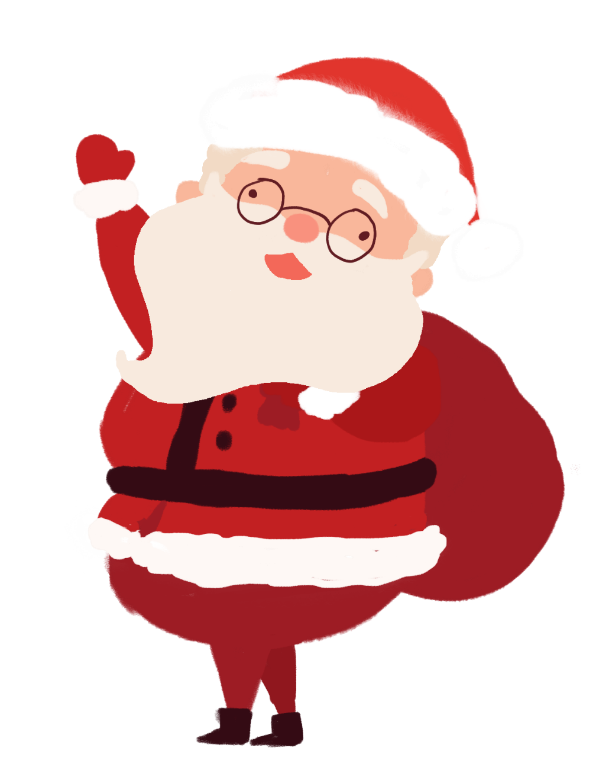
Christmas Eve and the following day
1
Arrival time at 8 or 8:30
2
Eat with the family
3
Do the gift exchange around 12 am
NhanNgocThach – For Educational Use Only
4
The next day after the party, go to mass with the whole family to welcome baby Jesus.

Slide 10
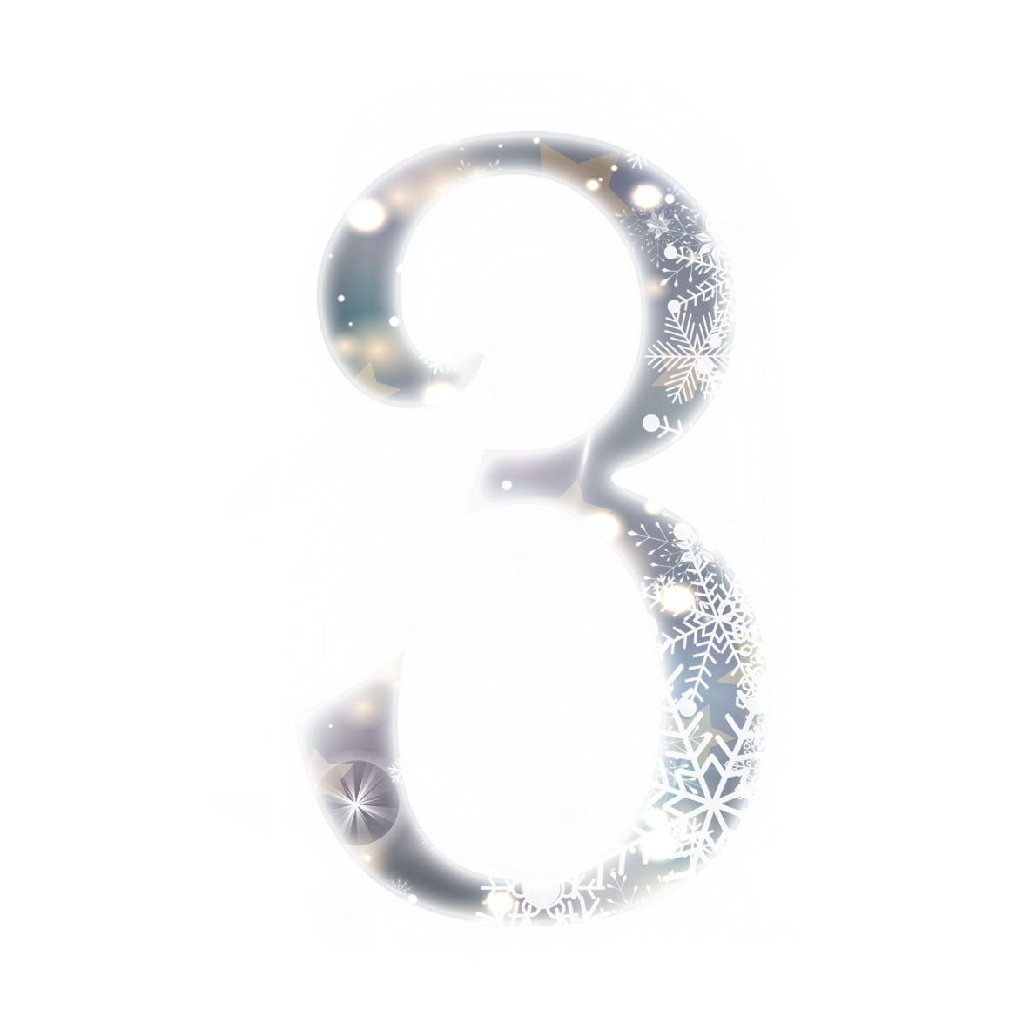
Special Foods
& Drinks
NhanNgocThach – For Educational Use Only

Slide 11
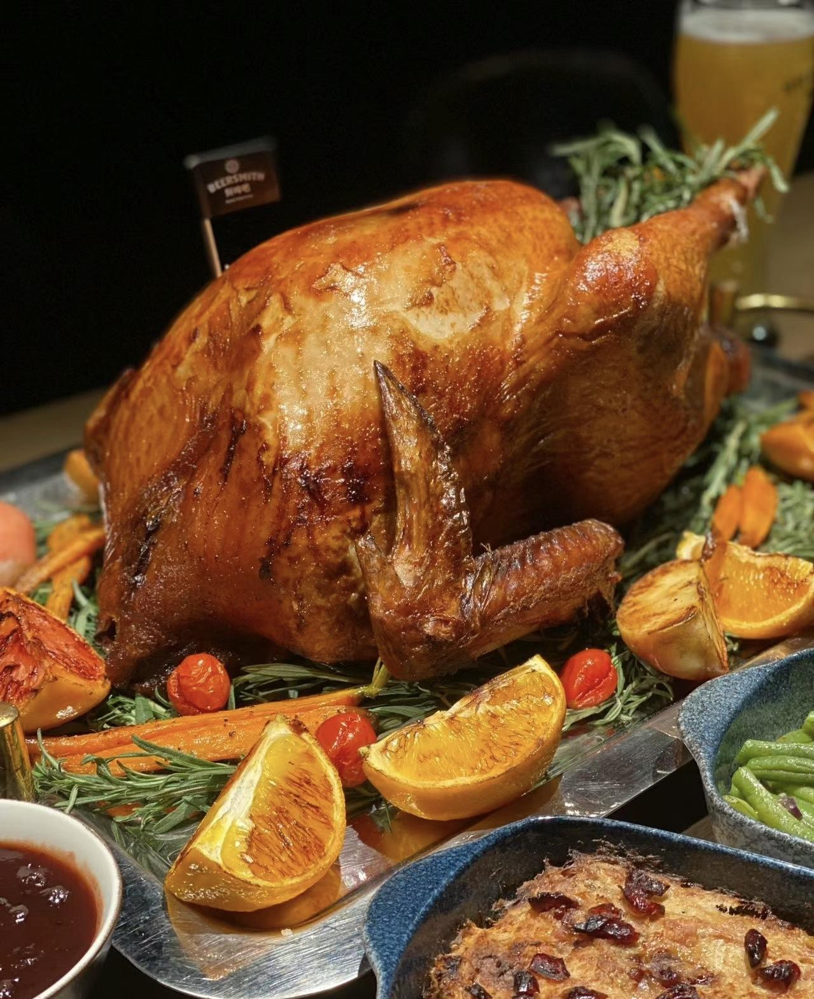
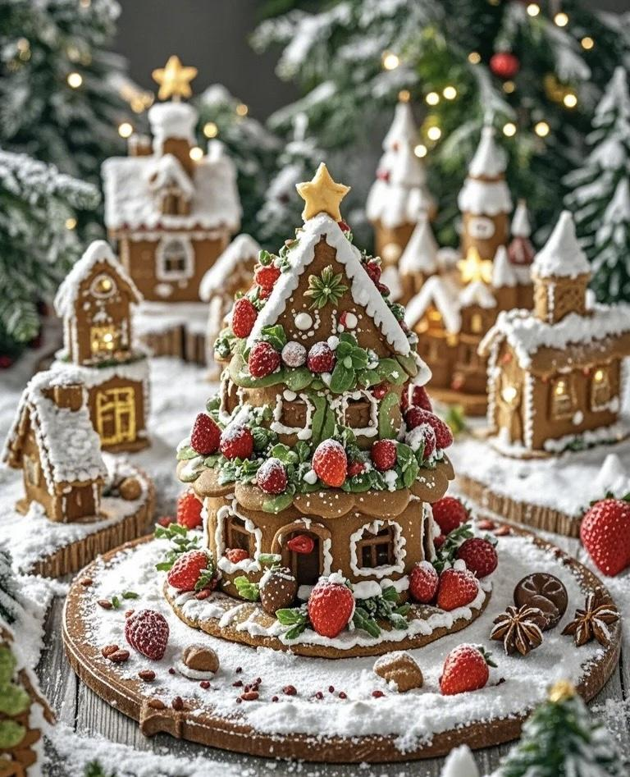
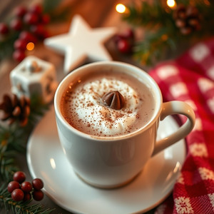
NhanNgocThach – For Educational Use Only

Slide 12
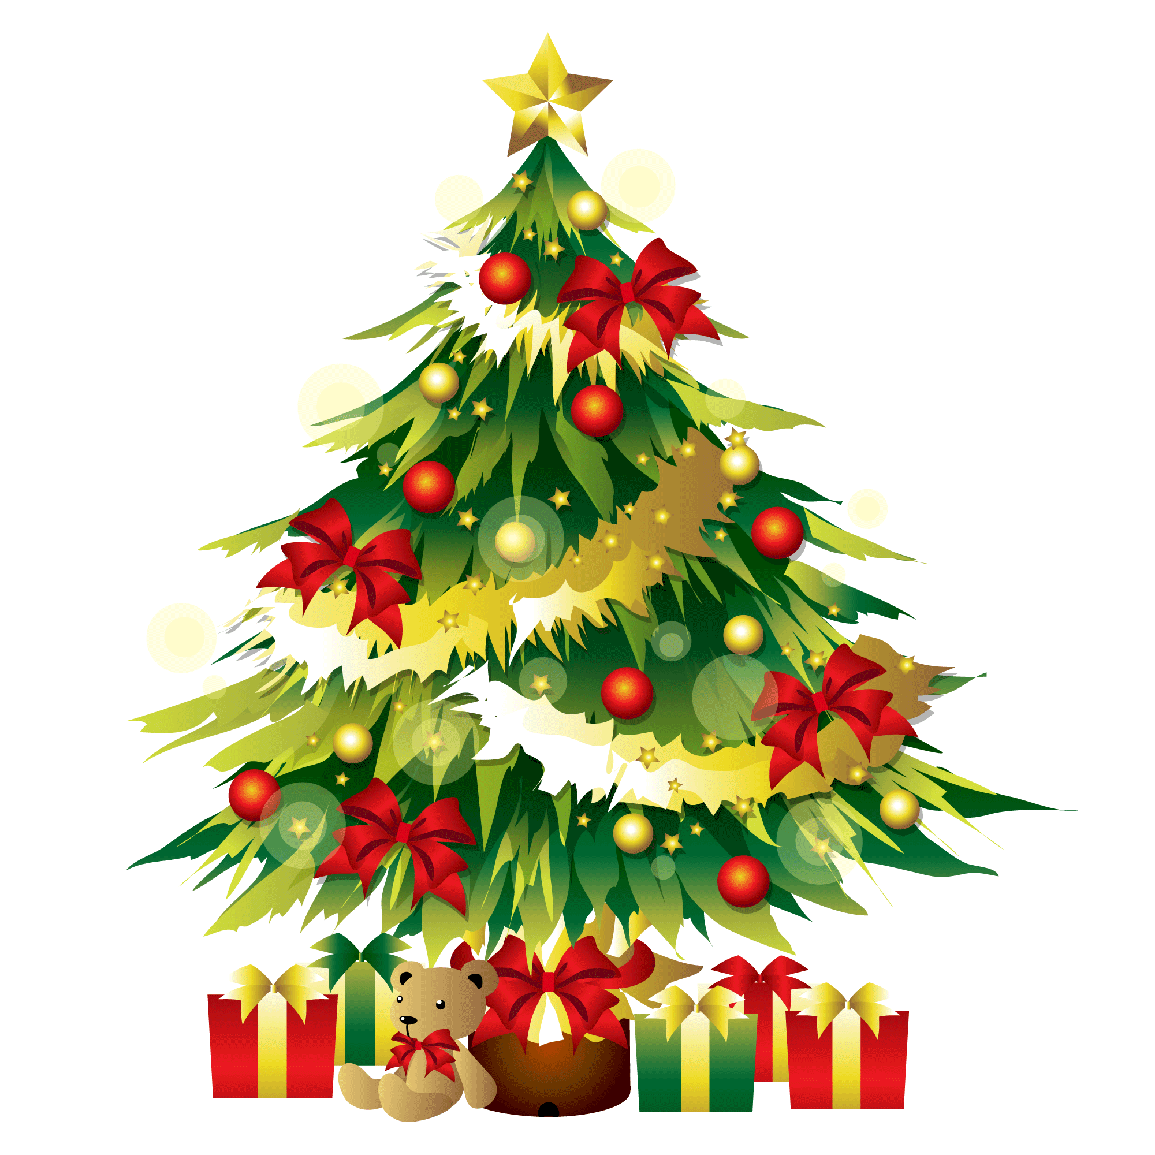
Christmas Turkey (Roast Turkey)
Roast Turkey is the star of the Christmas table. The dish is usually served with vegetables such as potatoes, carrots and peas, and is served with gravy and cranberry sauce. Turkey is a symbol of abundance and togetherness, and is a great dish for extended families during the holiday season.
Gingerbread
Gingerbread houses and gingerbread men are one of the most important symbols of Christmas, especially loved by children. The sweetness of gingerbread comes from honey, brown sugar and spices, and the cookies are shaped and decorated to symbolize the warmth of the holiday and the creativity of the family.
NhanNgocThach – For Educational Use Only
Notes:
Hot cocoa is a warm drink made from cacao powder, mixed with water or milk, and sometimes sweetened. people usually drink hot cocoa after a day playing in the snow

Slide 13
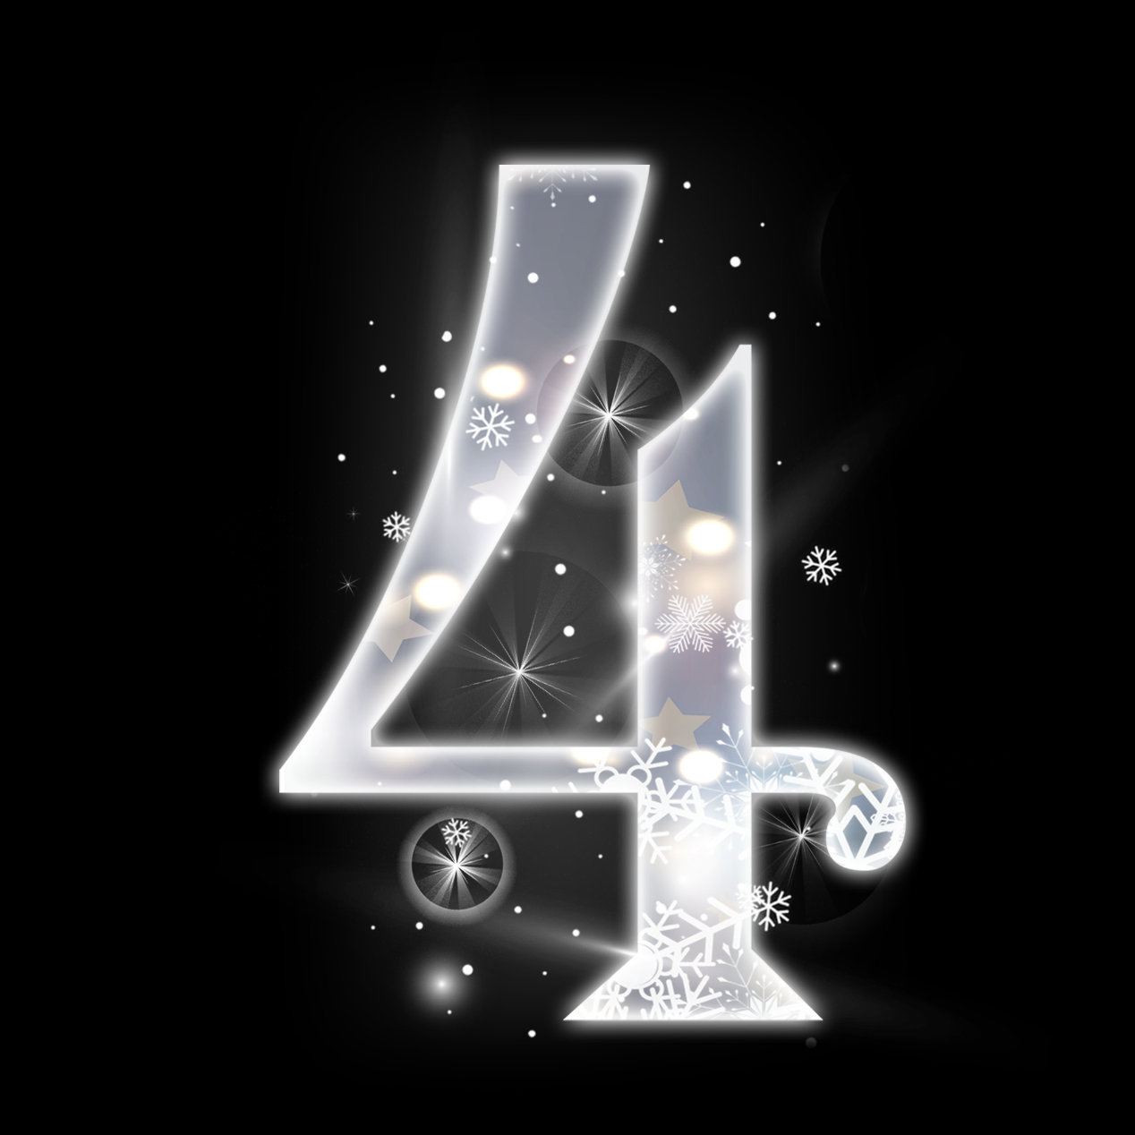
Decorations
& Symbols
NhanNgocThach – For Educational Use Only

Slide 14
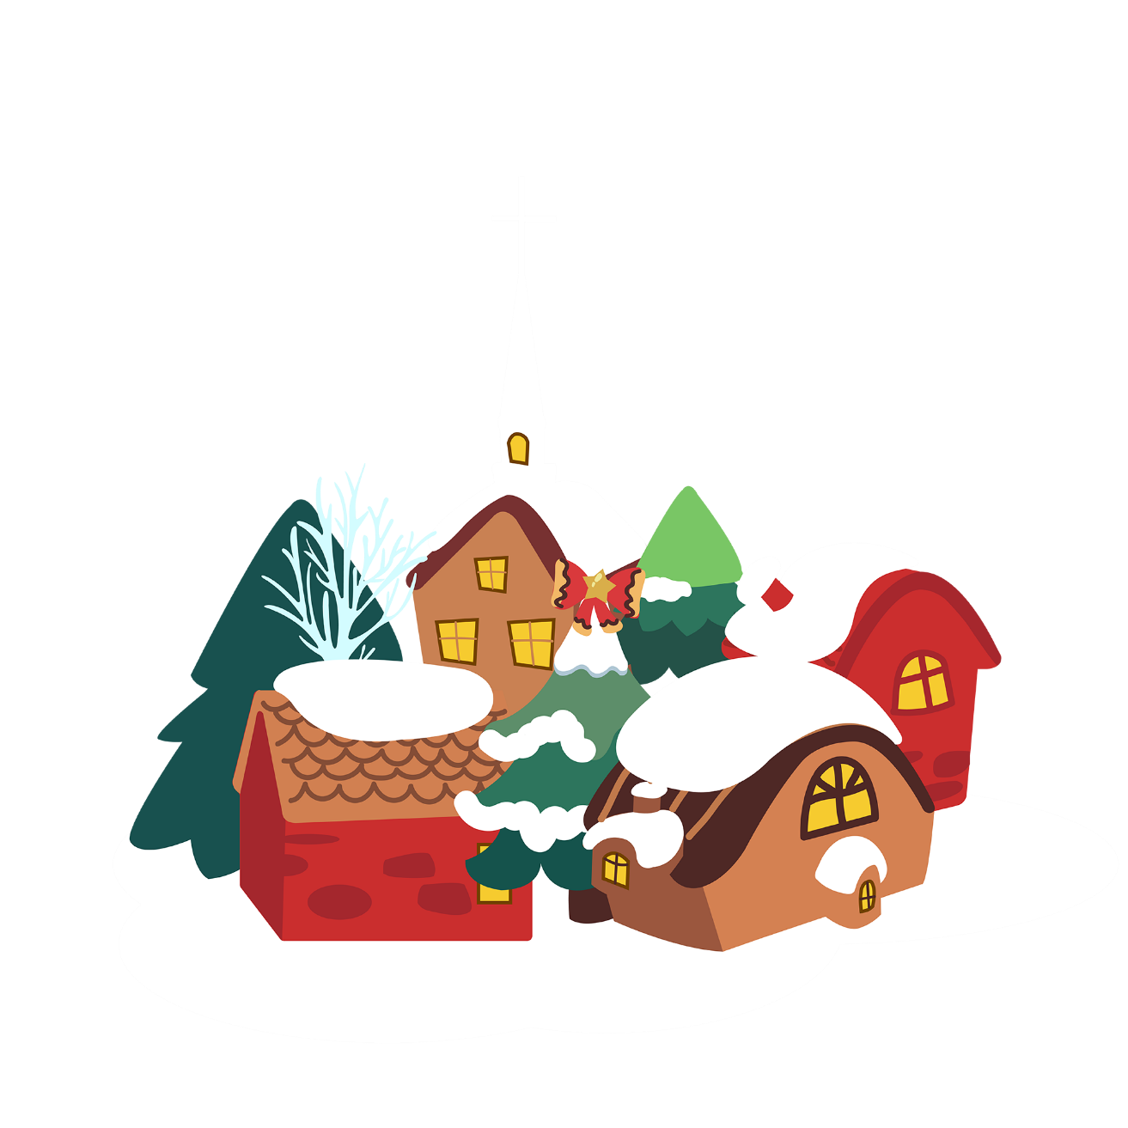
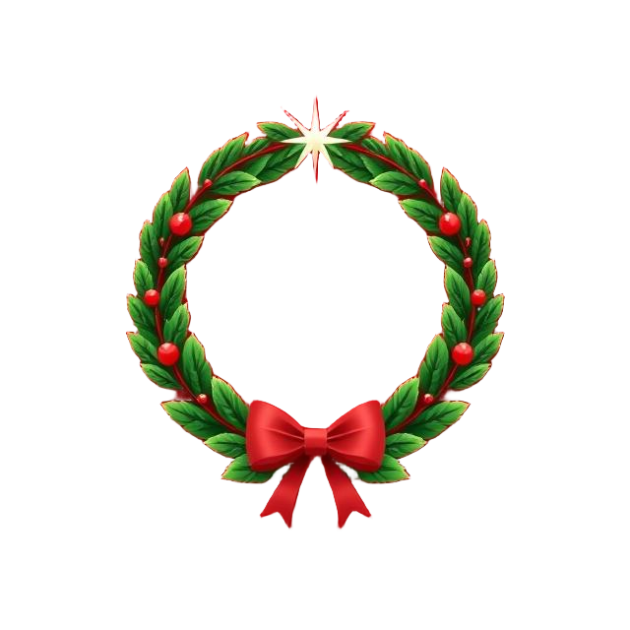
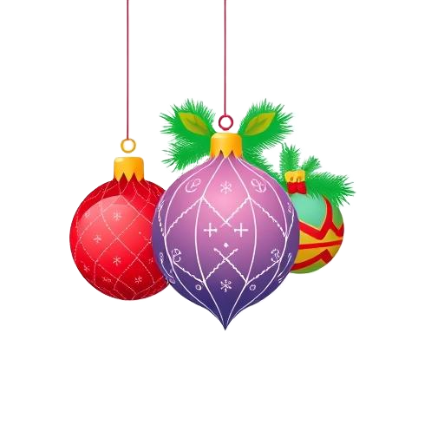
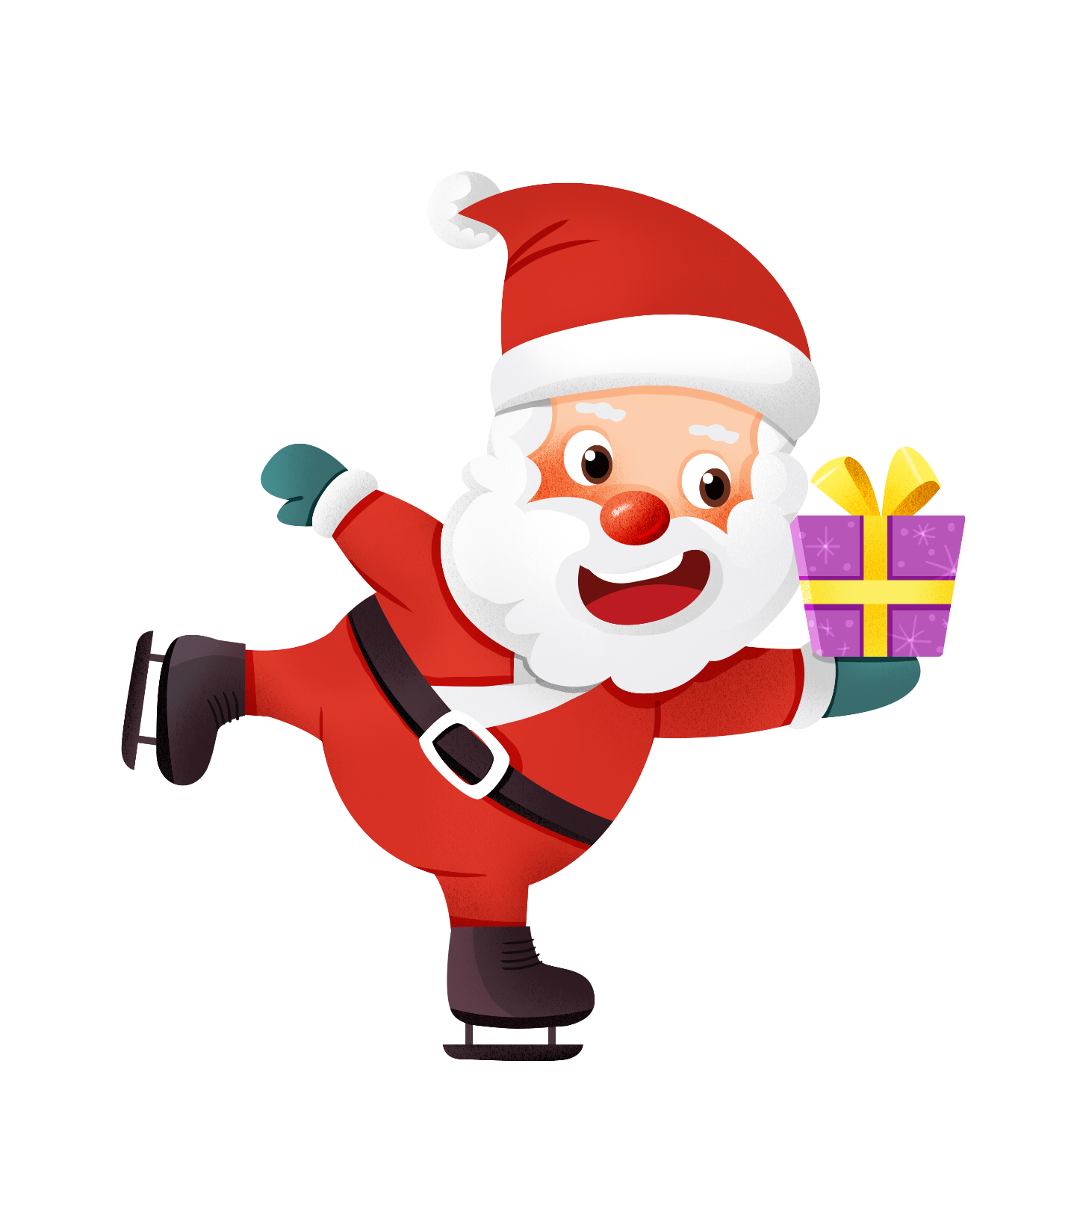

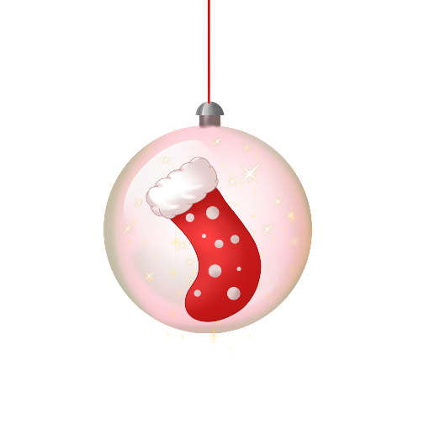

NhanNgocThach – For Educational Use Only
Notes:
Decorations: Christmas decorations are not only beautiful and eye catch, but also they has history and meaning.
Christmas Trees:
This is the most symbol of Christmas, these trees are decorated with lights, ornaments, and tinsel. Decorating the Christmas tree is a belove family activity, representing joy and together.
Laurel Wreaths: These wreaths, often made from evergreens, symbolize eternity and unending love. Hanging on doors, they welcome guests and spread festive cheer. Advent wreaths, along with candles, are especially significant in the Christian tradition.
Stockings: people usually decorate near the fireplace, Christmas tree or near their bed and waiting Santa comes and gives them gifts.
Colors: The colors of Christmas are not just random choices; they each hold special meanings and add to the festive atmosphere.
Red: Symbolizes the blood of Jesus Christ and is associated with warmth and love. It's commonly seen in Santa's suit and many decorations.
Green: Represents eternal life and rebirth, seen in the evergreen trees and wreaths that remain vibrant even in winter.
Gold and silver: are meaning richness,light, purity

Slide 15
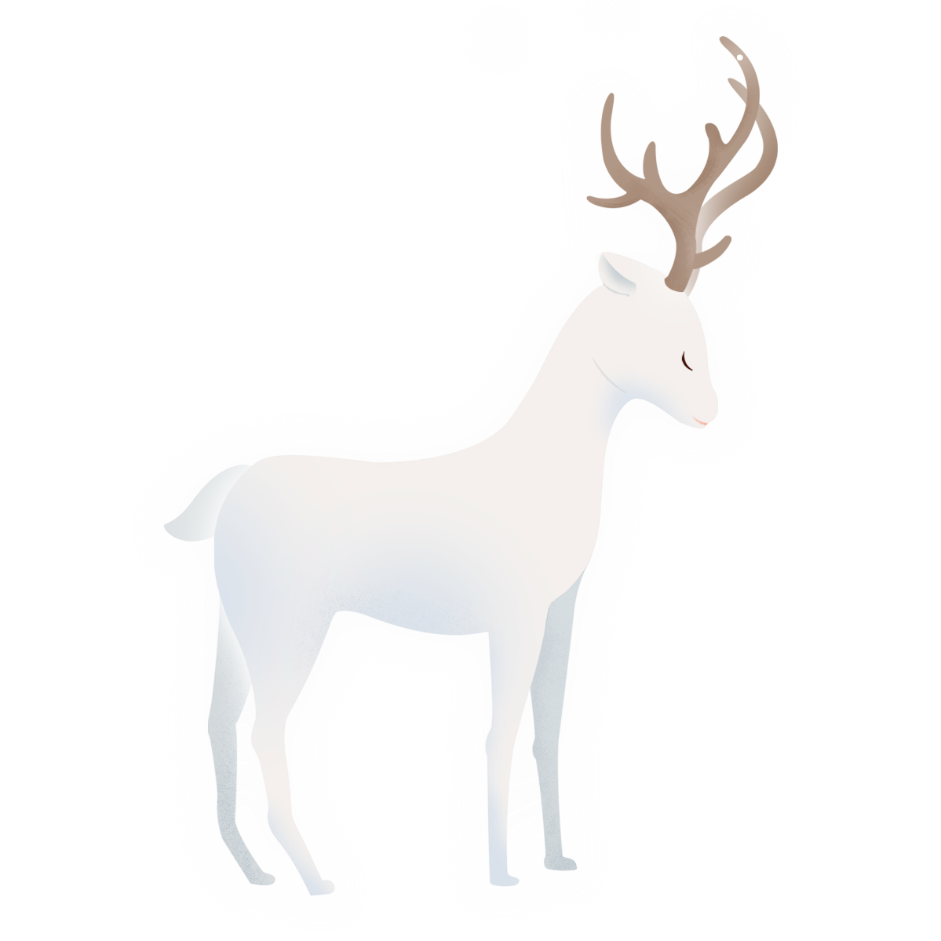
Thank you
NhanNgocThach – For Educational Use Only

